Slide 1
IOT
By Emad Sheikh Ansari , Mohammad Zaki Zade & Pedram Zahedi
Supervisor : Mohammad Laali
Kharazmi university – May , 2018

Slide 2
What is IOT?
The Internet of Things (IoT) is the network of physical objects—devices, vehicles, buildings and other items embedded with electronics, software, sensors, and network connectivity—that enables these objects to collect and exchange data.

Slide 3
Where is IoT?
It’s everywhere!

Slide 4
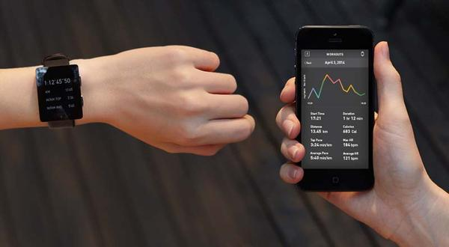
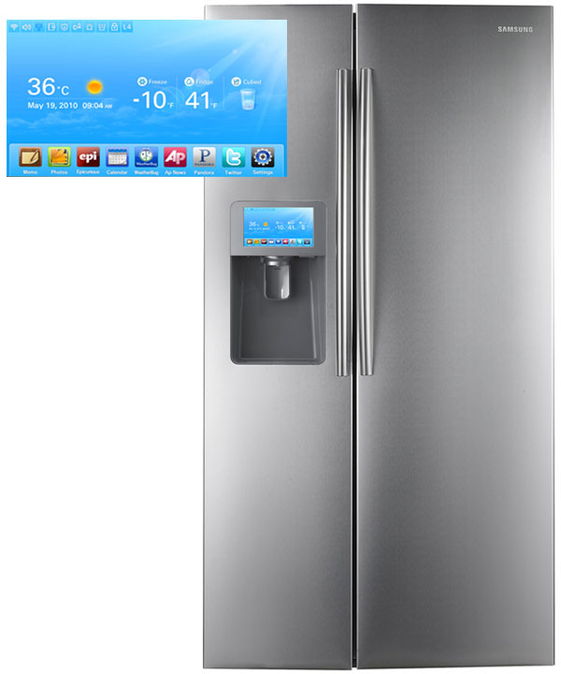
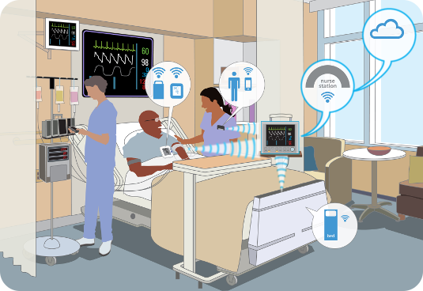
Smart Appliances
Wearable Tech
Healthcare

Slide 5
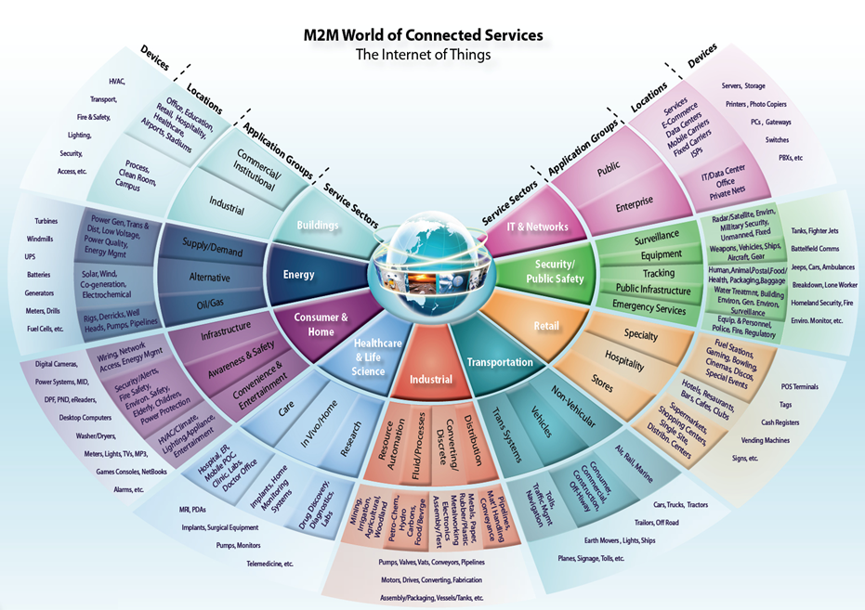

Slide 6
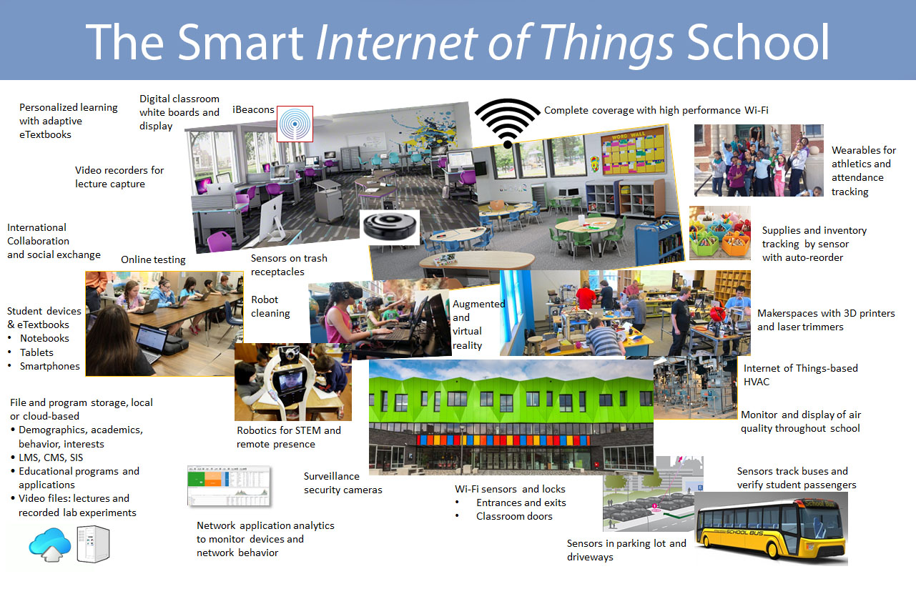
Information Security
Office of Budget and Finance
Education – Partnership – Solutions

Slide 7
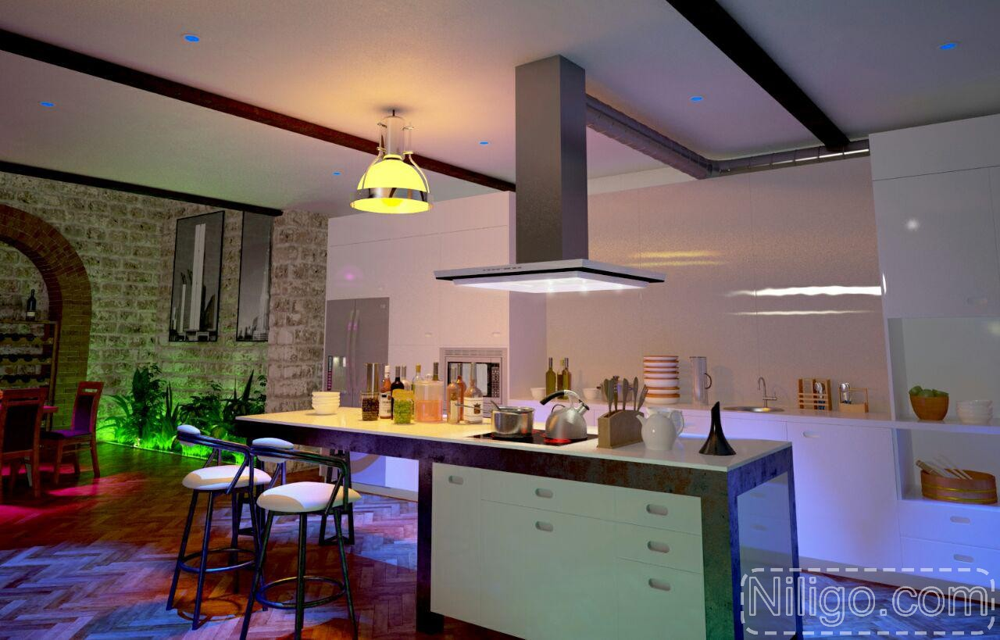




Slide 8

The IoT Market
As of 2013, 9.1 billion IoT units
Expected to grow to 28.1 billion IoT
devices by 2020

Slide 9

Why be concerned about IoT?
It’s just another computer, right?
All of the same issues we have with access control, vulnerability management, patching, monitoring, etc.
Imagine your network with 1,000,000 more devices
Any compromised device is a foothold on the network

Slide 10
What are we doing ?
Control led with Wifi

Slide 11
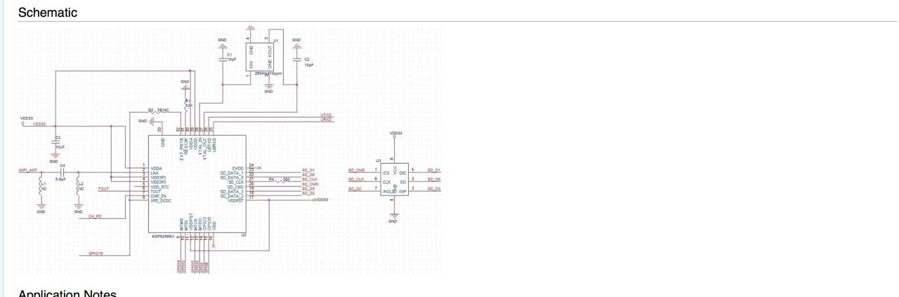

Slide 12
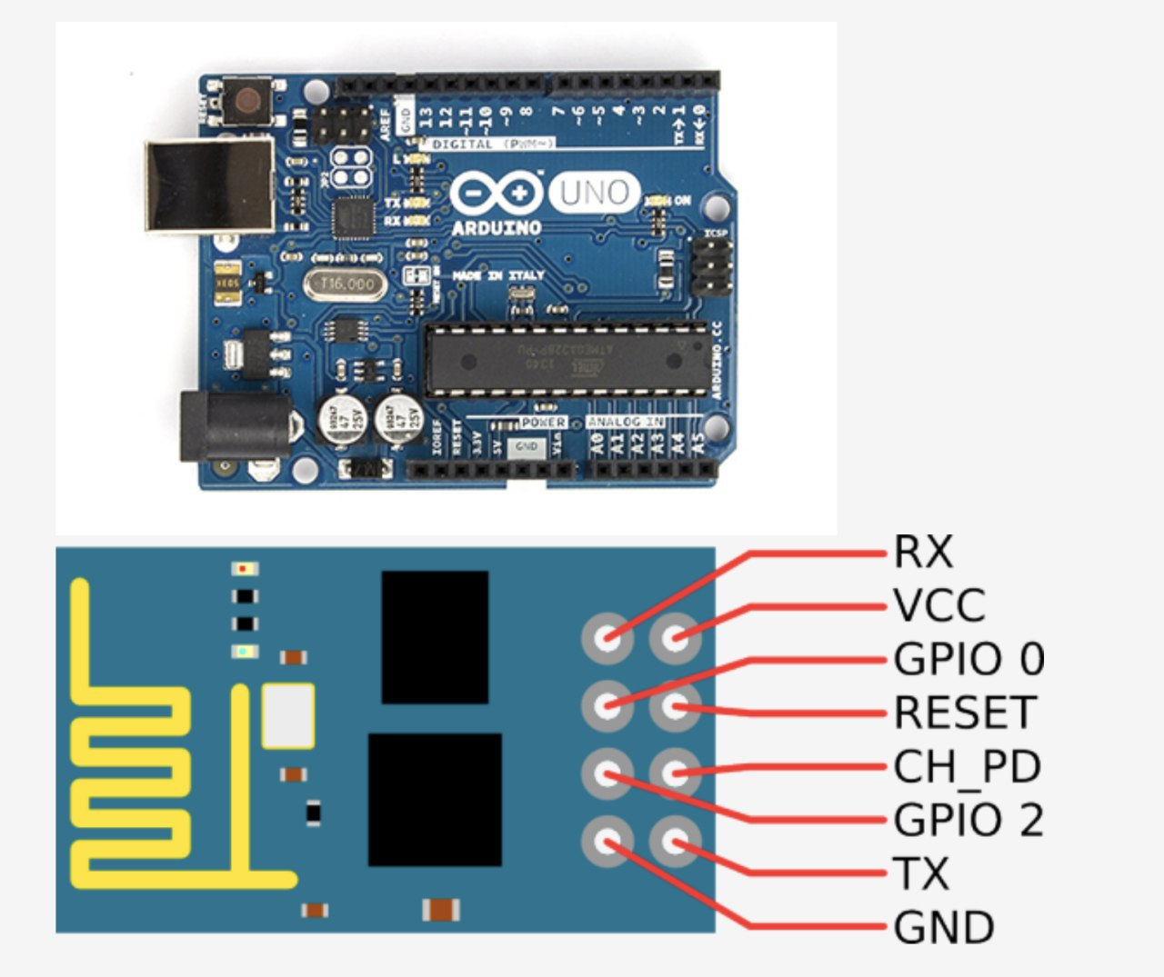

Slide 13
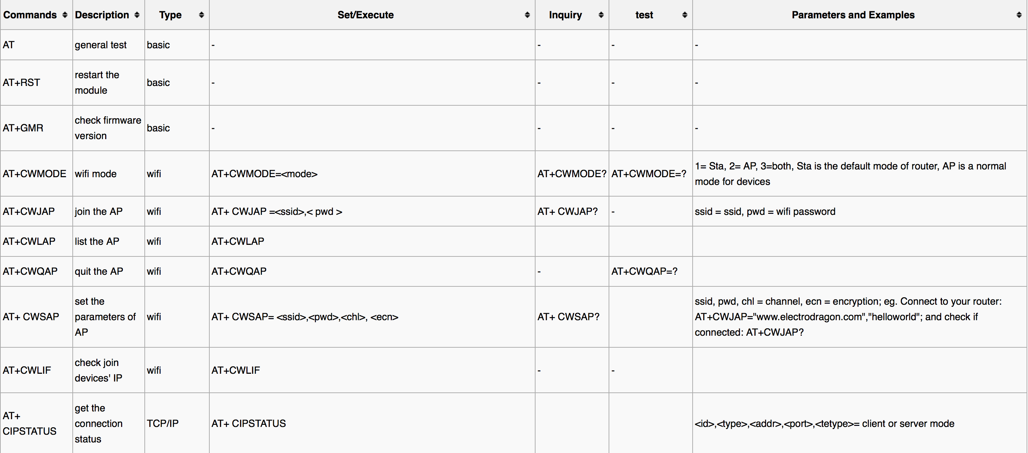

Slide 14
Refrences
http://www.utsystem.edu/offices/board-regents/uts165-standards
https://securityintelligence.com/the-importance-of-ipv6-and-the-internet-of-things/
http://www.isaca.org/Knowledge-Center/Research/ResearchDeliverables/Pages/internet-of-things-risk-and-value-considerations.aspx
https://www.owasp.org/images/7/71/Internet_of_Things_Top_Ten_2014-OWASP.pdf
https://www.owasp.org/images/3/36/IoTTestingMethodology.pdf
http://blog.sec-consult.com/2015/11/house-of-keys-industry-wide-https.html
http://blog.trendmicro.com/trendlabs-security-intelligence/high-profile-mobile-apps-at-risk-due-to-three-year-old-vulnerability/#
http://www.rs-online.com/designspark/electronics/knowledge-item/eleven-internet-of-things-iot-protocols-you-need-to-know-about
https://thenewstack.io/tutorial-prototyping-a-sensor-node-and-iot-gateway-with-arduino-and-raspberry-pi-part-1
http://www.business.att.com/content/article/IoT-worldwide_regional_2014-2020-forecast.pdf
http://blog.talosintel.com/2016/02/trane-iot.html
http://krebsonsecurity.com/2016/02/iot-reality-smart-devices-dumb-defaults/
http://www.gsma.com/connectedliving/gsma-iot-security-guidelines-complete-document-set/

Slide 15
Thanks for your attention
Any Questions ?

